Slide 1
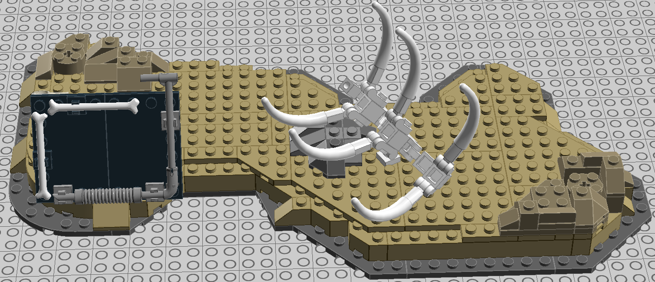
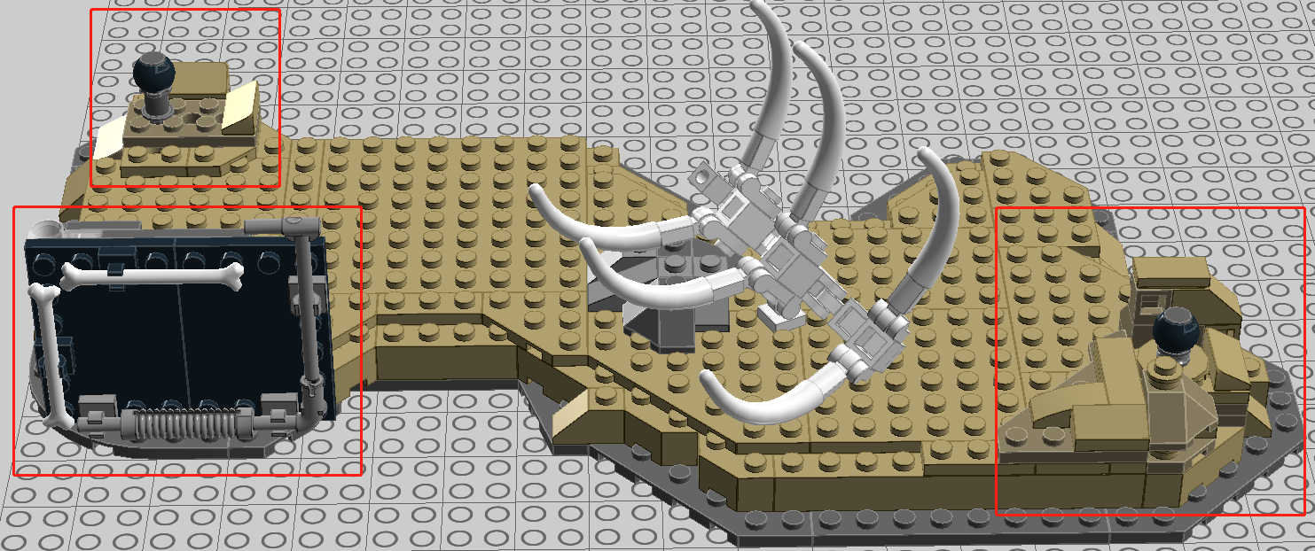
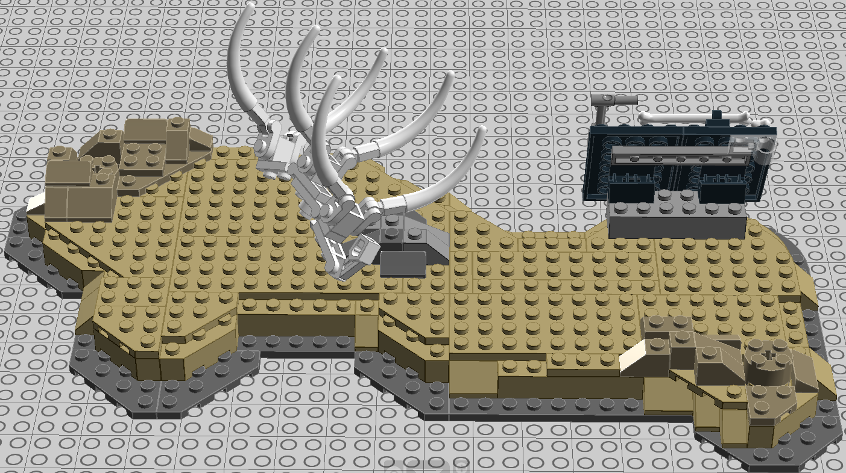
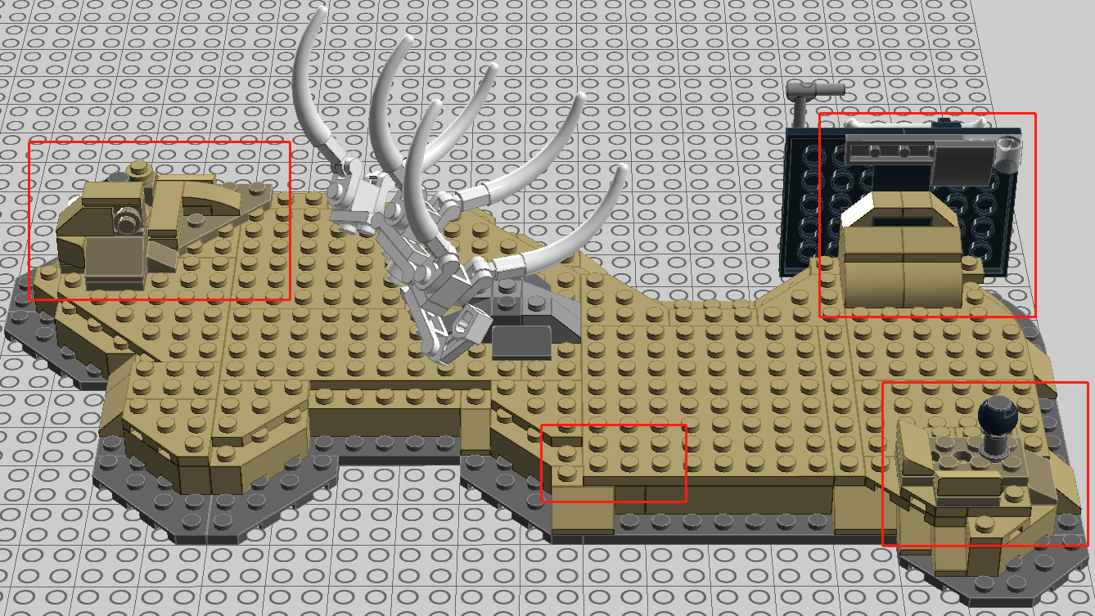
70101
Enhanced Version 70001
The structures marked in red boxes were modified to make it stronger.

Slide 2
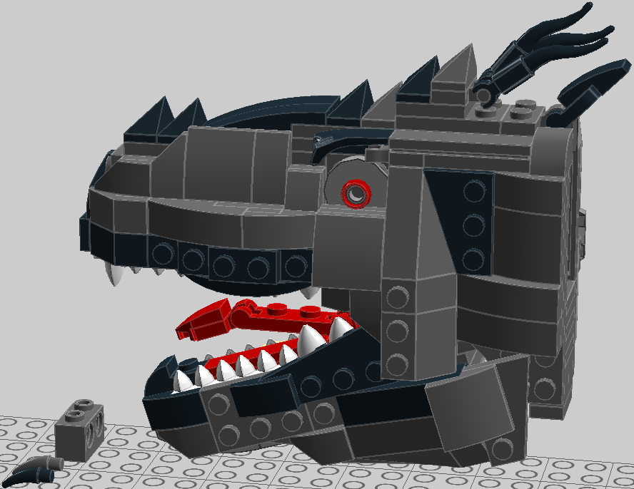
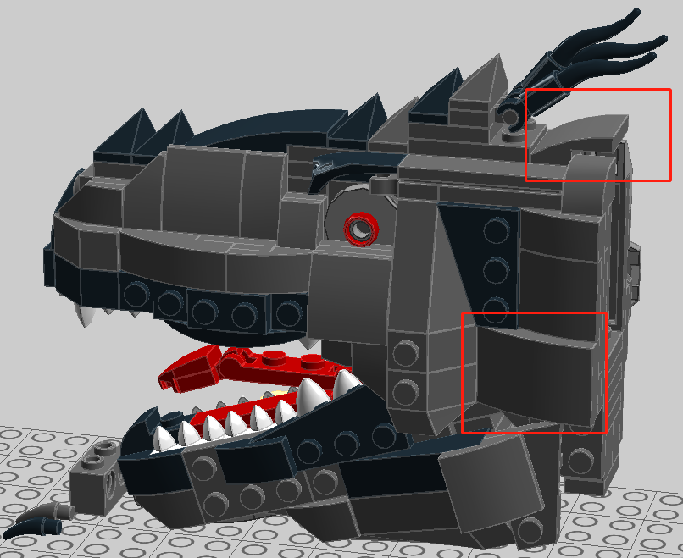
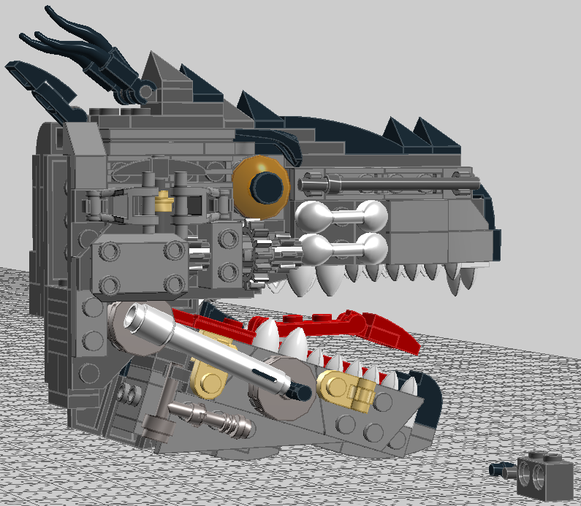
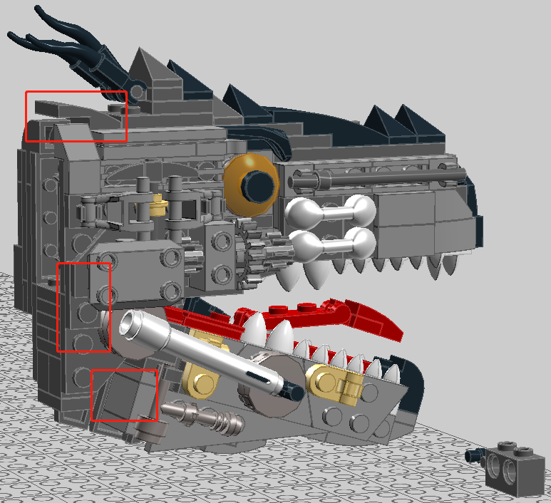
70101
Enhanced Version 70001
The structures marked in red boxes were modified to make it stronger.

Slide 3
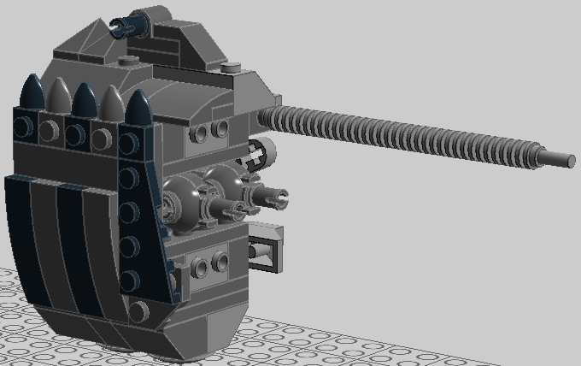
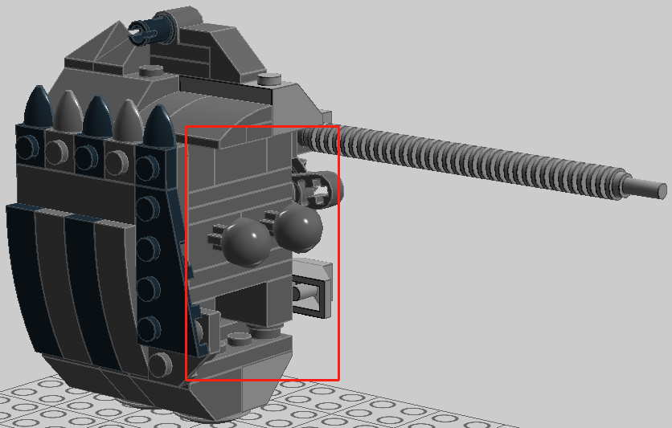
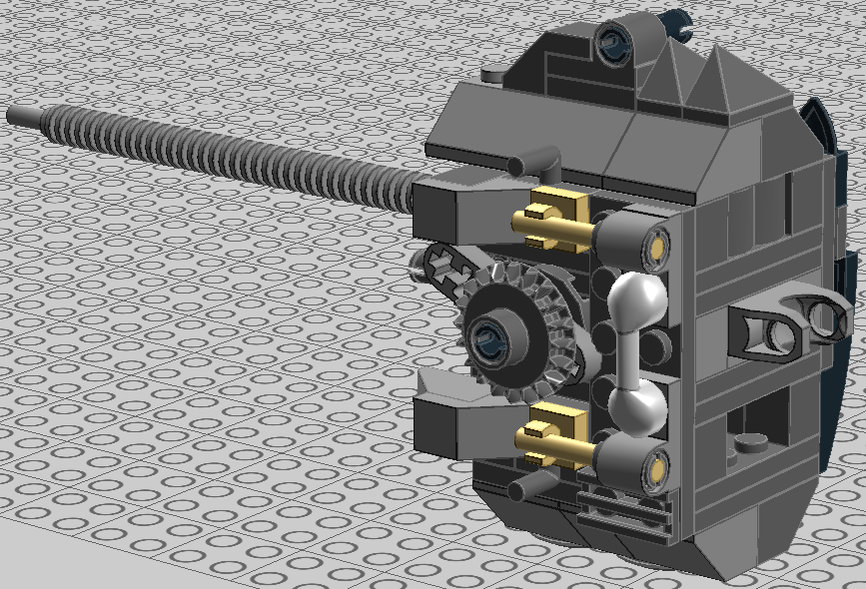
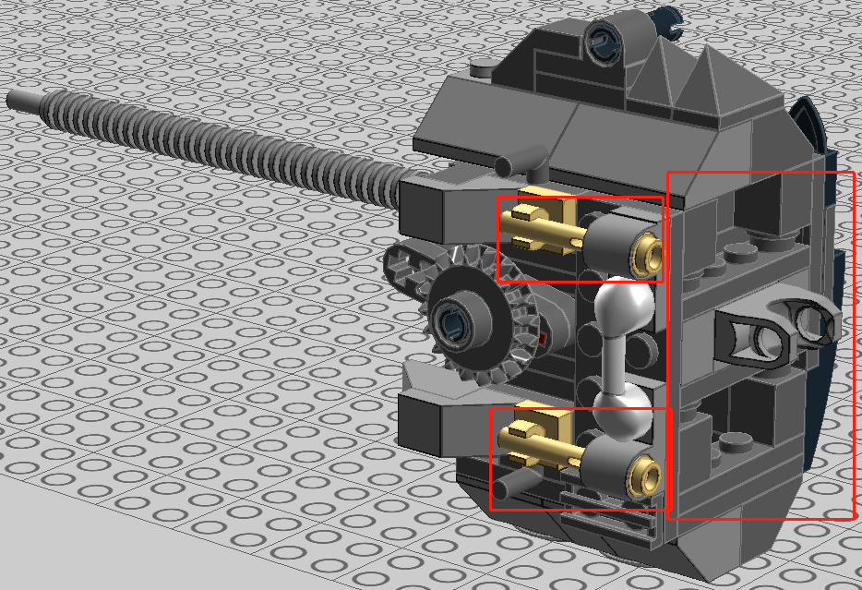
70101
Enhanced Version 70001
The structures marked in red boxes were modified to make it stronger.

Slide 4




70101
Enhanced Version 70001
The structures marked in red boxes were modified to make it stronger.

Slide 5
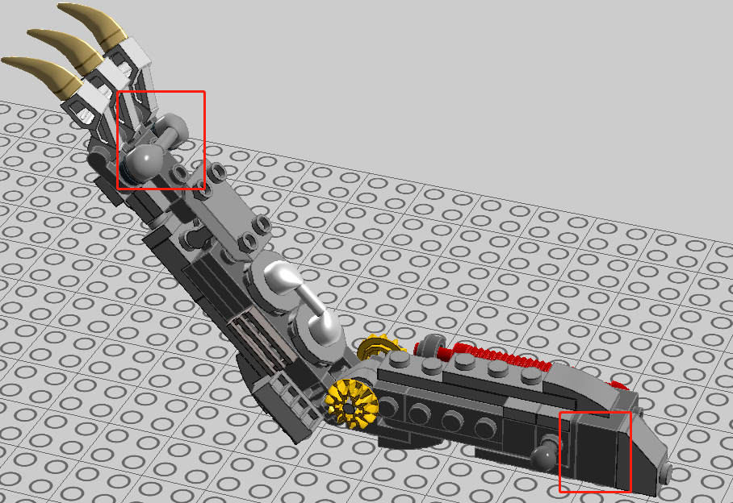
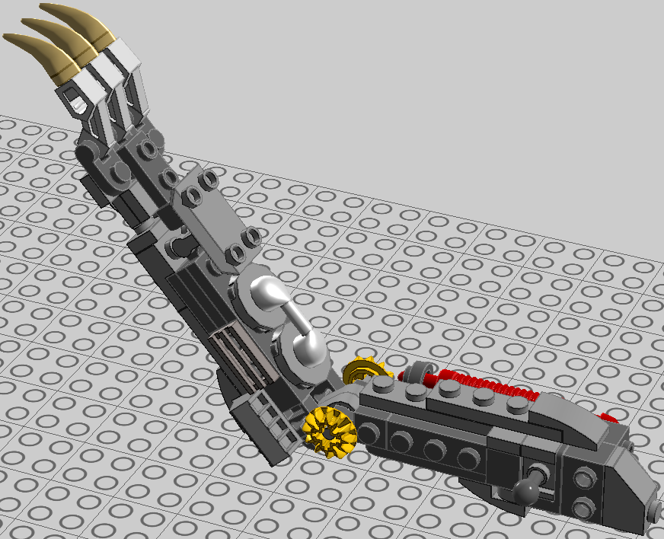


70101
Enhanced Version 70001
The structures marked in red boxes were modified to make it stronger.

Slide 6
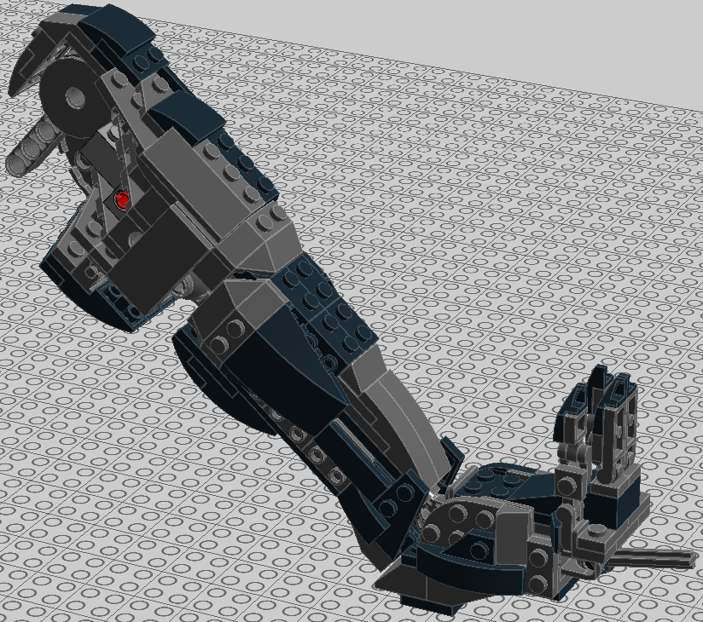
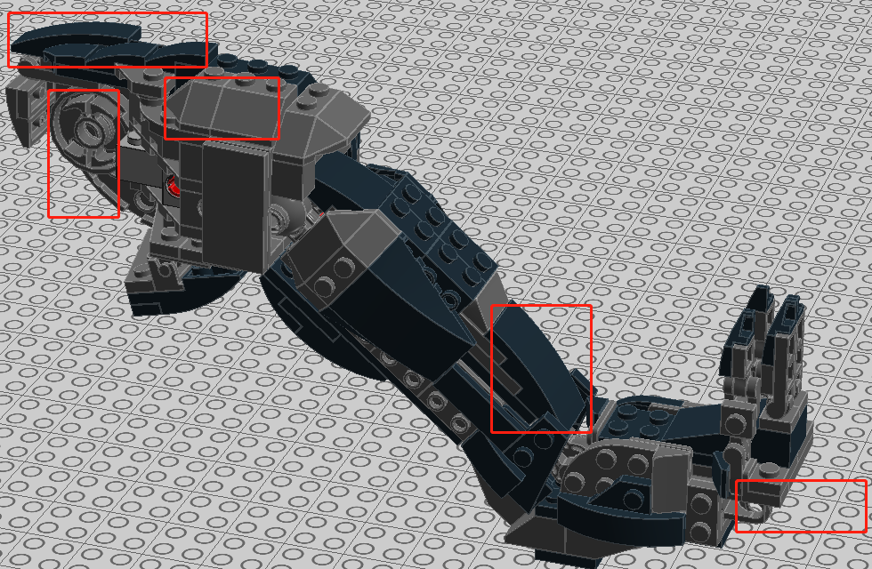
70101
Enhanced Version 70001
Improve the structures in red boxes to make them more secure, and adjusted the order of assembly in some pieces.

Slide 7


70101
Improve the structures in red boxes to make them more secure, and reduced some pieces that fitted tightly.
Enhanced Version 70001

Slide 8

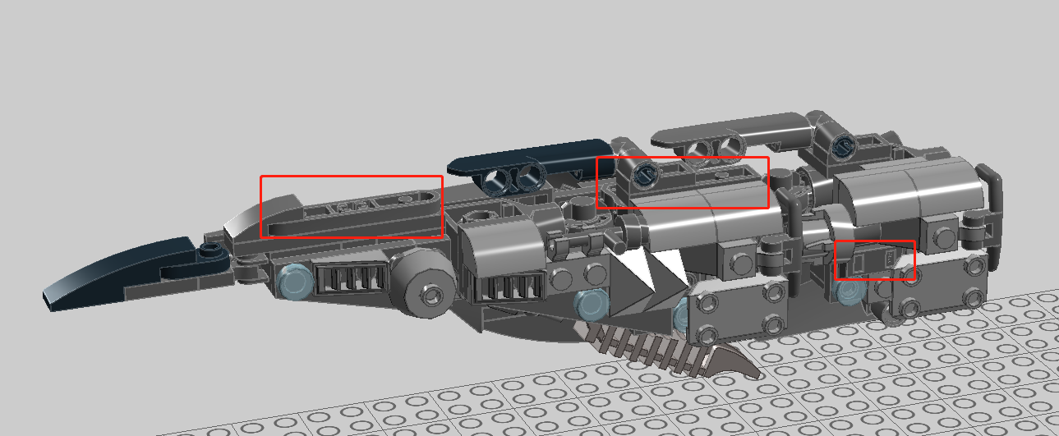
70101
The structures marked in red boxes were modified to make it stronger.
Enhanced Version 70001

Slide 9
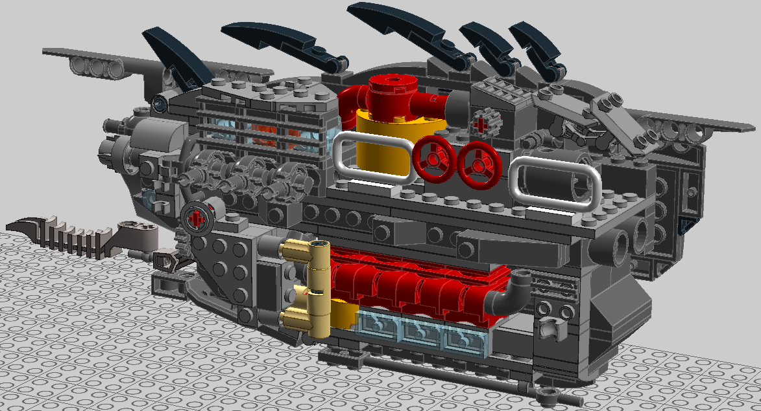
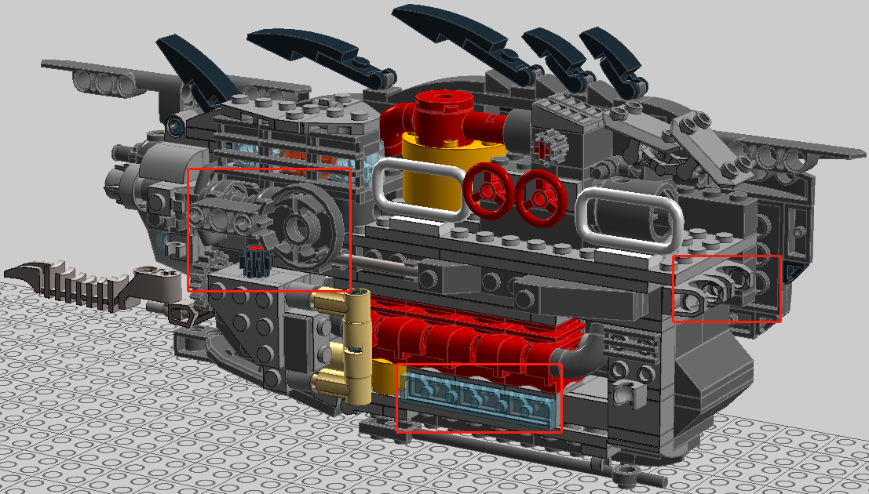
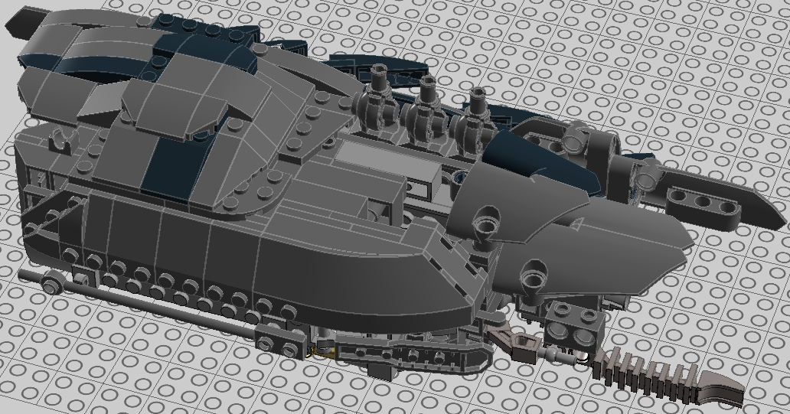
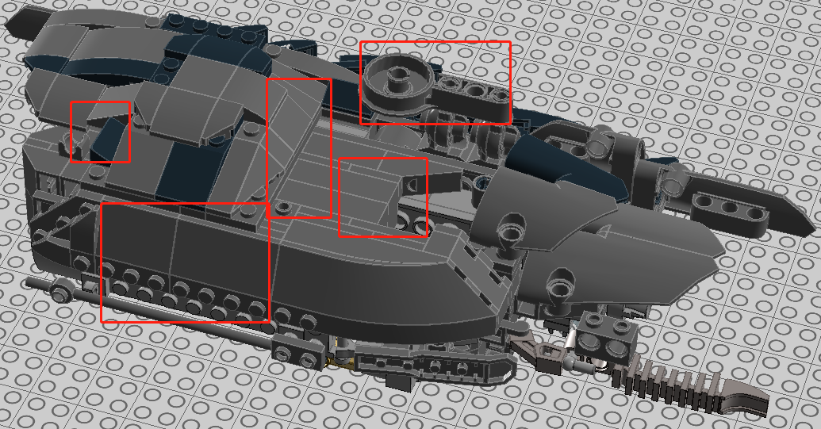
70101
Enhanced Version 70001
The structures marked in red boxes were modified to make it stronger.

